Slide 1
Pseudoalignment for Matagenomic Read Assignment
COM SCI M229S Paper Presentation
Xiyuan Jiang
Cong Peng

Slide 2
Outline
1. Intro
2. Methods and results
3. Conclusion and future work

Slide 3
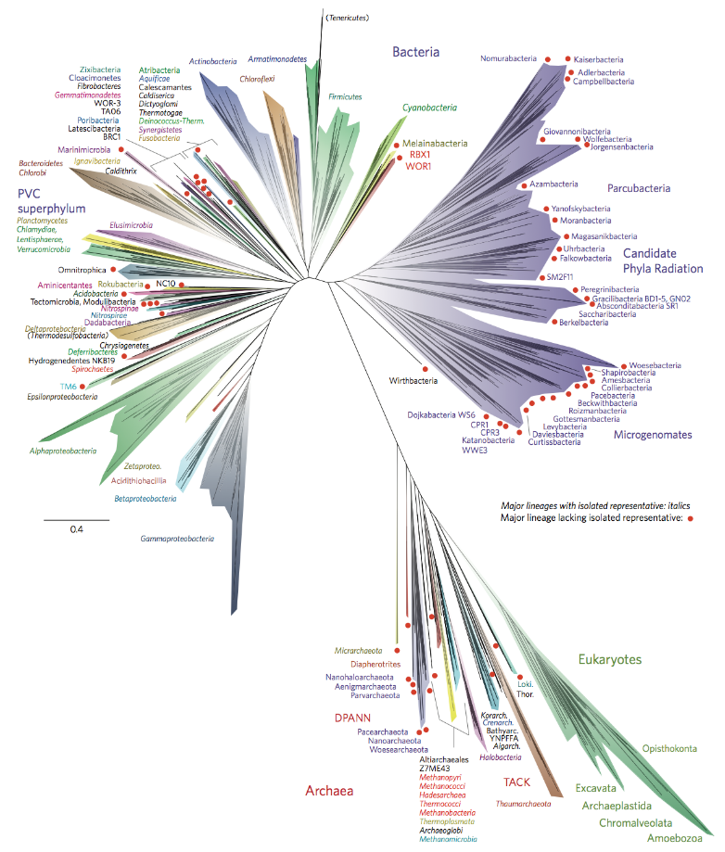

Introduction of metagenomes
Metagenomics is the study of genetic material recovered directly from environmental samples.
Notes:
Metagenomics is the study of genetic material recovered directly from environmental samples.

Slide 4

Introduction of metagenomes
Metagenomics is the study of genetic material recovered directly from environmental samples.
Problem: read assignment, assigning sequenced reads to taxa.
Notes:
One of the fundamental metagenomics problems that is amenable to reference-based analysis is that of “sequence classiﬁcation” or “read assignment”. This is the problem of assigning sequenced reads to taxa.

Slide 5
Metagenomics vs RNA-Seq
 | Metagenomics | RNA-Seq
Similarity | Assign genomic reads into a specific group
Difference | Map reads at a strain level Genomic sequences are larger Reference database less complete | Map read to a specific isoform Transcripts are relatively small Reference database well established

Slide 6
Apply RNA-Seq methodology to metagenomics
Origin: [Paulson et al., 2013] [] Statistical methods for identifying diﬀerential abundances in microbial marker genes were developed
[1] Paulson, J. N., Stine, O. C., Bravo, H. C., and Pop, M. (2013). Diﬀerential abundance analysis for microbial marker-gene surveys. Nature methods, 10(12):1200–1202.
Notes:
Recently there are researches to apply RNA-Seq methodology to metagenomics, and validate the effectiveness of this kind of application. For example, (read ppt)

Slide 7
Programs comparison
Program | Pros | Cons
MEGAN[] | Assign reads to lowest taxonomic level Powerful visualization toolkit | Ambiguous mapping reads ignores individual strains Computation problem
Kraken[] | Instead of read alignment, k-mer hashing | Speed at a cost
Kallisto[] | More accurate Faster(“negligible”) | (currently not found in the paper)
Other related work: eXpress, CLARK, GASiC, GRAMMy……
[?]Huson, D. H., Auch, A. F., Qi, J., and Schuster, S. C. (2007). MEGAN analysis of metagenomic data. Genome research, 17(3):377–386.
[?]Wood, D. E. and Salzberg, S. L. (2014). Kraken: ultrafast metagenomic sequence classiﬁcation using exact alignments. Genome Biology, 15(3):R46.
Notes:
MEGAN: The MEGAN program [Huson et al., 2007] was one of the ﬁrst reference-based read assignment programs and was published shortly after sequencing-by-synthesis methods started to become mainstream
Kraken: In a breakthrough publication in 2014 [Wood and Salzberg, 2014] it was shown that it is possible to greatly accelerate read assignment utilizing fast k-mer hashing to circumvent the need for read alignment. An implementation called Kraken was used to show that analyses that previously took hours were tractable in minutes, and the removal of the read alignment step greatly simpliﬁed workﬂows and storage requirements.
An examination of the Kraken algorithm and output reveals that the method takes a step back from GRAMMy and GASiC by discarding statistical assignment of reads at the strain level in favor of direct taxonomic assignment as in MEGAN (notably according to [Lindgreen et al., 2015], Kraken is more accurate than MEGAN although, as we’ll see, it is not as accurate as GASiC).

Slide 8
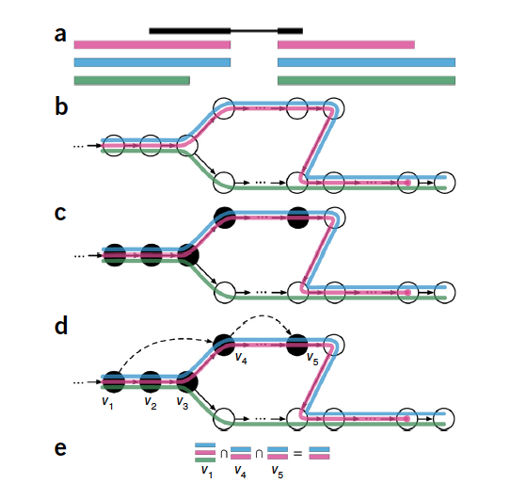
Pseudoalignment
Basic idea of kallisto (pseudoalignment)
Notes:
Figure 1 Overview of kallisto. The input consists of a reference transcriptome
and reads from an RNA-seq experiment. (a) An example of a read (in black)
and three overlapping transcripts with exonic regions as shown. (b) An index
is constructed by creating the transcriptome de Bruijn Graph (T-DBG) where
nodes (v1, v2, v3, ... ) are k-mers, each transcript corresponds to a colored
path as shown and the path cover of the transcriptome induces a
k-compatibility class for each k-mer. (c) Conceptually, the k-mers of a read are
hashed (black nodes) to find the k-compatibility class of a read. (d) Skipping
(black dashed lines) uses the information stored in the T-DBG to skip k-mers
that are redundant because they have the same k-compatibility class. (e) The
k-compatibility class of the read is determined by taking the intersection
of the k-compatibility classes of its constituent k-mers.

Slide 9
Methods and Results
1. Hypothesis test: RNA-Seq quantification can be applied in he metagenomics setting
2. Performance evaluation: meta-kallisto performs better than state-of-the-art algorithms.

Slide 10
1. Hypothesis test:
Hypothesis: RNA-Seq quantification methods can be applied in the metagenomics setting
Validation: Exam the performance of eXpress^{[1]}.
Reasons to choose:
a) eXpress utilizes traditional read alignments directly to a transcriptome.
b) eXpress is more memory efficient than other approaches.
[1] Roberts, Adam, and Lior Pachter. "Streaming fragment assignment for real-time analysis of sequencing experiments." Nature methods 10.1 (2013): 71-73.
Notes:
Validation: a program
that implements a streaming EM algorithm for RNA-Seq read assignment from align-
ments, on simulated data [Roberts and Pachter, 2013]
b) Such as RSEM [Li and Dewey, 2011]), therefore is more suitable for metagenomics settings.

Slide 11
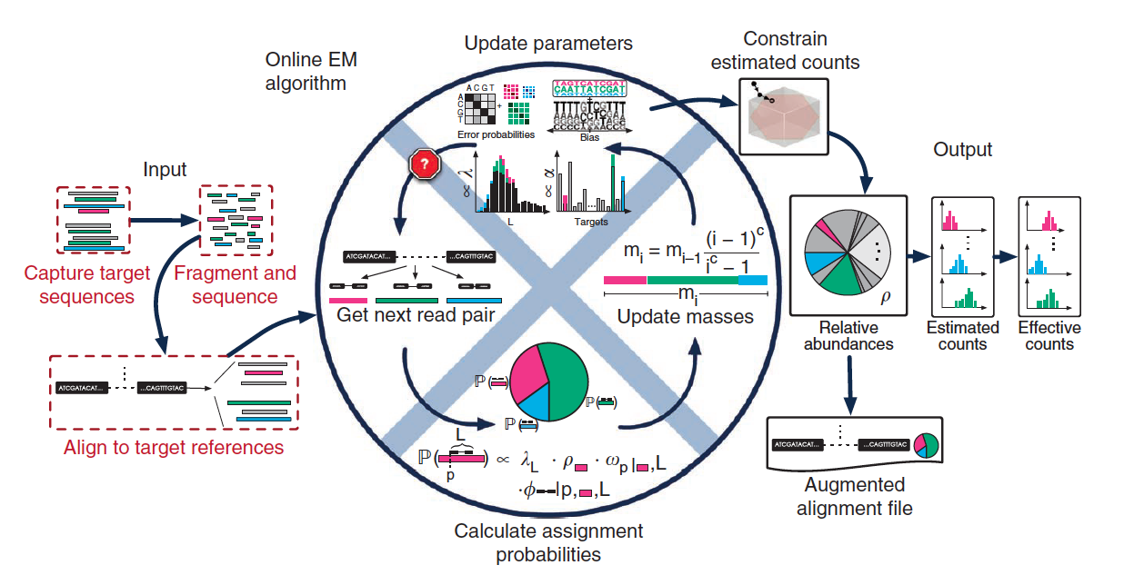
1. Hypothesis test:
Overview of eXpress
Notes:
Overview of eXpress. The input consists of either single or paired-end reads aligned to a set of target sequences and provided in a file or streamed to eXpress. For single fragments that map to multiple sites, assignment probabilities are calculated for each site given previous estimates of target-sequence abundances (initially a uniform prior is used). Next, a ‘forgetting mass’ (m) is calculated, and partial counts are distributed to the target sequences according to the assignment probability. Parameters for fragment-length (L) distribution, sequence bias and sequence read errors are updated in a similar fashion and used in the next round of assignment. Once the input data have been processed, relative abundances are calculated from the count distributions, as are distributions of estimated and effective counts. An alignment file that includes mapping probabilities can be generated. eXpress can determine whether further sequencing is needed by monitoring relative abundances, making it applicable to real-time sequencing and analysis.

Slide 12
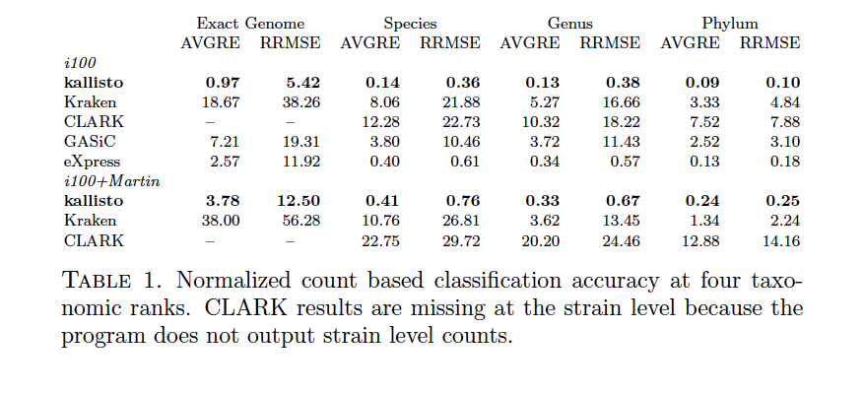
1. Hypothesis test:
Dataset: Illumina-like reads from 100 microbial genomes to a reference database^{[2]} containing only those genomes.
Benchmark: GASiC, one method for utilizing read alignments for read assignment.
Taxonomic rank
low
high
[2] Mende, D. R., Waller, A. S., Sunagawa, S., Jrvelin, A. I., Chan, M. M., Arumugam, M., Raes, J., and Bork, P. (2012). Assessment of Metagenomic Assembly Using Simulated Next Generation Sequencing Data. PLoS ONE, 7(2):e31386.
Notes:
Dataset : allowing us to compare results to a ground truth (the Illumina100 data)
A major problem with GASiC and eXpress is that the alignments they require are slow to generate. The alignments, made with Bowtie2 [Langmead and Salzberg, 2012], took days.
The Illumina100 dataset consists of 53.33 million 75bp reads, simulated by the iMESSi metagenomic simulator using an Illumina error model. The reads were simulated from a set of 100 unique bacterial genomes. The set is of genomes from 85 diﬀerent species and 63 diﬀerent genuses, over a range of abundances from 0.86% to 2.2%.

Slide 13
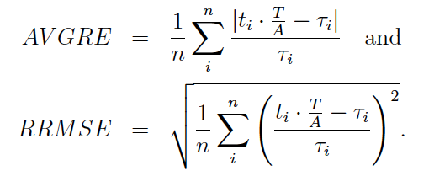
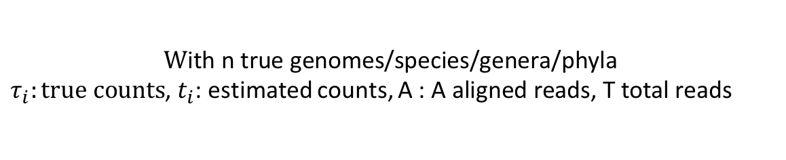
1. Hypothesis test:
$$W\text{ith} \text{n} \text{true} \text{genomes}\text{/}\text{species}\text{/}\text{genera}\text{/}\text{phyla}$$
$τ_{i}:true counts$, $t_{i}$: estimated counts, A : $\text{A} \text{aligned} \text{reads}\text{,} \text{T} \text{total} \text{reads}$

Slide 14
1. Hypothesis test:
Dataset: Illumina-like reads from 100 microbial genomes to a reference database containing only those genomes.
Benchmark: GASiC, one method for utilizing read alignments for read assignment.
Taxonomic rank
low
high
Major problem for eXpress and GASiC: alignment SLOW!!
Notes:
Dataset : allowing us to compare results to a ground truth (the Illumina100 data)
A major problem with GASiC and eXpress is that the alignments they require are slow to generate. The alignments, made with Bowtie2 [Langmead and Salzberg, 2012], took days.

Slide 15
1. Hypothesis test:
Benckmark: Kraken and CLARK
Taxonomic rank
low
high
Mini-conclusion: eXpress outperforms Kraken, GASiC and CLARK.
Notes:
As reported in [Wood and Salzberg, 2014], Kraken was much faster on the data, taking only 22 minutes 38s. We also tested CLARK [Ounit et al., 2015], another
recently published k-mer based assignment tool and, in agreement with the benchmarks in [Lindgreen et al., 2015], we found it to be slightly faster taking 20 minutes 30s.
However, as seen in Table 1, both Kraken and CLARK have signicantly worse performance
than both GASiC and eXpress (in concordance with [Lindgreen et al., 2015] but in con-
tradiction to [Ounit et al., 2015], we found that Kraken is more accurate than CLARK).

Slide 16
2. Performance evaluation
Algorithms to be compared: kallisto, Kraken and CLARK
A larger and more realistic reference database of 1,958 genomes
Notes:
We next turned to a comparison of kallisto with Kraken and CLARK using the Illumina100 simulation (i100) but utilizing a larger and more realistic reference database of 1,958 genomes from [Martin et al., 2012
kallisto is much more accurate than Kraken and CLARK at all four taxonomic levels tested. The performance of kallisto at the exact genome level is signicantly better than Kraken at the genus level. Notably, Kraken‘s performance at the exact genome level (AVGRE 18.67 and RRMSE38.26) is too poor to be of practical use.

Slide 17
2. Performance evaluation
kallisto
Count
Psylum
Kraken
CLARK
Notes:
Results of kallisto (top), Kraken (middle) and CLARK (bot-
tom) on simulated reads from the i100+Martin dataset at the phylum
level.

Slide 18
2. Performance evaluation
kallisto
Count
Genus
Kraken
CLARK
Notes:
Results of kallisto (top), Kraken (middle) and CLARK (bot-
tom) on simulated reads from the i100+Martin dataset at the genus level.

Slide 19
2. Performance evaluation
kallisto
Count
Species
Kraken
CLARK
Notes:
Results of kallisto (top), Kraken (middle) and CLARK (bot-
tom) on simulated reads from the i100+Martin dataset at the genus level.

Slide 20
2. Performance evaluation
kallisto
Count
Exact genome
Kraken
Notes:
Results of kallisto (top), Kraken (middle) and CLARK (bot-
tom) on simulated reads from the i100+Martin dataset at the genus level.

Slide 21
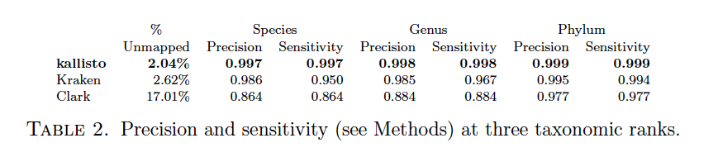
2. Performance evaluation
Algorithms to be compared: kallisto, Kraken and CLARK
A larger and more realistic reference database of 1,958 genomes
Notes:
We next turned to a comparison of kallisto with Kraken and CLARK using the Illumina100 simulation (i100) but utilizing a larger and more realistic reference database of 1,958 genomes from [Martin et al., 2012
kallisto is much more accurate than Kraken and CLARK at all four taxonomic levels tested. The performance of kallisto at the exact genome level is signicantly better than Kraken at the genus level. Notably, Kraken‘s performance at the exact genome level (AVGRE 18.67 and RRMSE38.26) is too poor to be of practical use.
The running time of kallisto is faster than Kraken with the i100 dataset (5m55s vs.
22m38s using a single core) but slower on the i100+Martin (50m55s vs. 27m3s). However
kallisto index building is slightly faster than Kraken, and when utilizing multiple threads
for pseudoalignment, kallisto's running time is negligible.

Slide 22
2. Performance evaluation
[3]
$$sensitivity= \frac{(\# of counts correctly assigned at rank R}{\# of counts assigned at rank R}$$
$$precision= \frac{\# of counts correctly assigned at or below rank R}{\begin{aligned}\# of counts assigned at or below rank R + \\ \# of reads incorrectly assigned above rank R\end{aligned}}$$
[3]Langmead, B. and Salzberg, S. L. (2012). Fast gapped-read alignment with Bowtie 2. Nature methods, 9(4):357–359.
Notes:
In addition, for comparison of programs using the metrics in [Wood and Salzberg, 2014], we calculated the assignment aggregate precision and sensitivity of kallisto, Kraken and CLARK. Instead of examining the results of assignments of individual reads to speciﬁc species or genus, we relaxed the benchmark to instead measure sensitivity and precision based on aggregate counts at taxonomic ranks. Mimicking the computations of [Wood and Salzberg, 2014], we computed the aggregate sensitivity at a given rank R by calculating (# of counts correctly assigned at rank R)/(# of counts assigned at rank R).
6 L. SCHAEFFER, H. PIMENTEL, NICOLAS BRAY, P. MELSTED, AND L. PACHTER
Aggregate precision was calculated as (# of counts correctly assigned at or below rank R)/(# of counts assigned at or below rank R + # of reads incorrectly assigned above rank R). Counts at a rank were considered to be correctly assigned when they were less than or equal to the true counts. Our level of granularity in assessing assignment reﬂects the quantity of interest in reference-based metagenomics, namely the accuracy of the aggregate number of counts assigned to individual members of a rank instead of the correctness of each individual read assignment.

Slide 23
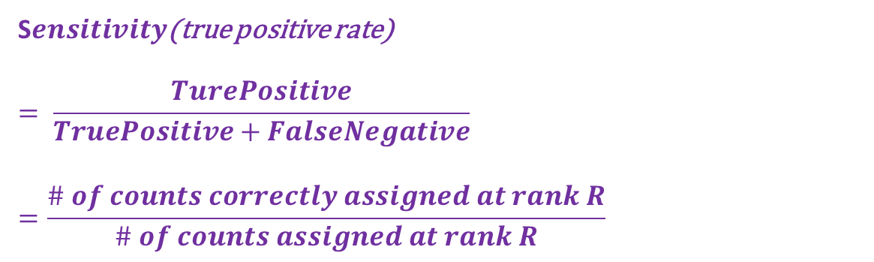
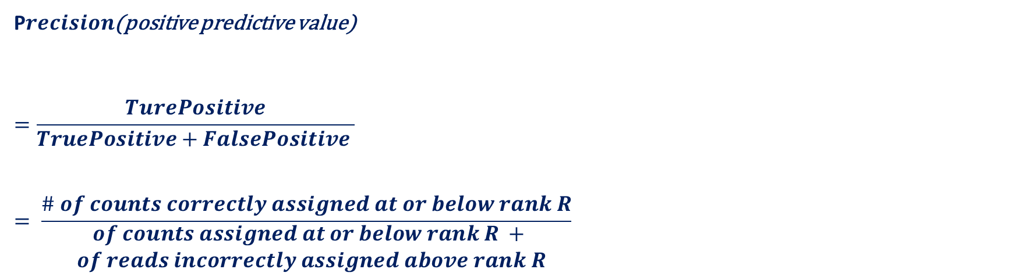
2. Performance evaluation
S$ensitivity$(true positive rate)
$$= \frac{TurePositive}{TruePositive+FalseNegative}=\frac{\# of counts correctly assigned at rank R}{\# of counts assigned at rank R}$$
P$recision$(positive predictive value)
$$=\frac{TurePositive}{TruePositive+FalsePositive }$$
$$= \frac{\# of counts correctly assigned at or below rank R}{\begin{aligned}\# of counts assigned at or below rank R + \\ \# of reads incorrectly assigned above rank R\end{aligned}}$$
Notes:
In addition, for comparison of programs using the metrics in [Wood and Salzberg, 2014], we calculated the assignment aggregate precision and sensitivity of kallisto, Kraken and CLARK. Instead of examining the results of assignments of individual reads to speciﬁc species or genus, we relaxed the benchmark to instead measure sensitivity and precision based on aggregate counts at taxonomic ranks. Mimicking the computations of [Wood and Salzberg, 2014], we computed the aggregate sensitivity at a given rank R by calculating (# of counts correctly assigned at rank R)/(# of counts assigned at rank R).
6 L. SCHAEFFER, H. PIMENTEL, NICOLAS BRAY, P. MELSTED, AND L. PACHTER
Aggregate precision was calculated as (# of counts correctly assigned at or below rank R)/(# of counts assigned at or below rank R + # of reads incorrectly assigned above rank R). Counts at a rank were considered to be correctly assigned when they were less than or equal to the true counts. Our level of granularity in assessing assignment reﬂects the quantity of interest in reference-based metagenomics, namely the accuracy of the aggregate number of counts assigned to individual members of a rank instead of the correctness of each individual read assignment.

Slide 24
2. Performance evaluation
Then the cases of missing strains are examined.
A strain is missing but other similar strains are in the database: removed Bacillus cereus ATCC1 0987, leaving a number of other Bacilii.
A strain distant from others is missing: removed Listeria welshimeri serovar 6b str. SLCC5334, leaving no other Listerias.
Notes:
While the results of kallisto on the i100 and i100+Martin databases were convincing, we decided to examine its performance in the case of missing strains, a situation that is commonplace in metagenomic analyses.

Slide 25
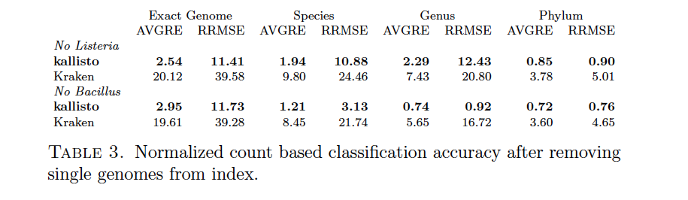
2. Performance evaluation
Then the cases of missing strains are examined.
Notes:
As expected, Table 3 shows that the performance of both kallisto and Kraken degrades
with removal of strains from the reference database. However, what is interesting is that
in the case of Bacillus, read assignment is still possible at the genus level as re
in improved performance. In the case of Listeria, the absence of neighboring species
means that the reads cannot be assigned. Remarkably, even with a strain completely
missing from the reference database, the performance of kallisto is still higher than that
of Kraken with all genomes present (compare to Table 1).

Slide 26
3. Conclusion and futurework
RNA-Seq methods for quantiﬁcation are also applicable in the metagenomics setting.
It is possible to accurately and rapidly quantify the abundance of individual strains.
The door is now open to metagenome analyses at the highest possible resolution.

Slide 27
3. Conclusion and futurework
The lack of attention paid to low taxonomic level analysis.
Spur others to standardize and organize naming conventions.

Slide 28
Question lists
Q1. In order to test the hypothesis that RNA-Seq can be applied on metagenomics setting, the author examined eXpress, why they also compared the results of eXpress with GASiC?
A1. As we know, the author ran eXpress program to test the hypothesis mentioned before. It is clear that eXpress is a program for RNA-Seq, while GASiC is a program for metagenomics analysis. In the first approach, the author evaluated the result of eXpress on metagenomics, and it turned out to be better than GASiC, which means that hypothesis is thus comfirmed.

Slide 29
Question lists
Q2. What is the meaning of ‘exact genome’ in terms of taxonomy?
A2. Across the paper, there are four taxonomic ranks, phylum, genus, species, and “exact genome” level. The exact genome is actually not a well-defined rank, which is a combination of strains and substrains. The purpose of adding this rank is because this paper wants to test the performance of killasto and other algorithms in high taxonomic resolution.

Slide 30
Question lists
Q3. In the computation of AVGRE, what’s the meaning of T/A in the expression?
A3. See blackboard.

Slide 31
Question lists
Q4. Why are counts considered correctly assigned when they were less than or equal to true counts? What’s the logic in it?
A4: If the estimated counts are larger than the true counts, it is not correct.

Slide 32
Question lists
Q4. What is the reason for not be aliened.
A4: Species not known, cannot sequence. Particularly true for metagenomics.

